Slide 1
The Airplane Boarding Problem
Modulation and Simulation

Slide 2
Introduction
1. Problem
2. Background knowledge
3. Related Work
4. Motivation
5. Simulation Plan
6. Implementation
7. Testing
8. Results
9. Conclusion
10. Future work

Slide 3
Problem
The cost to an airline company for each minute spent at the terminal is roughly $30
Turnaround critical path is the disembarkation of passengers, cabin servicing and passenger boarding
Boarding process is stressful for everyone, passengers and crew
Efficient passenger boarding can save a lot of time and money
There are efficient boarding methods which are not implemented in real-life scenarios due to their complexity and pre-ordering process
Notes:
What we want to do is minimize turnaround time. Minimize costs.
Show the problems we try to find the best solution to solve this problem

Slide 4
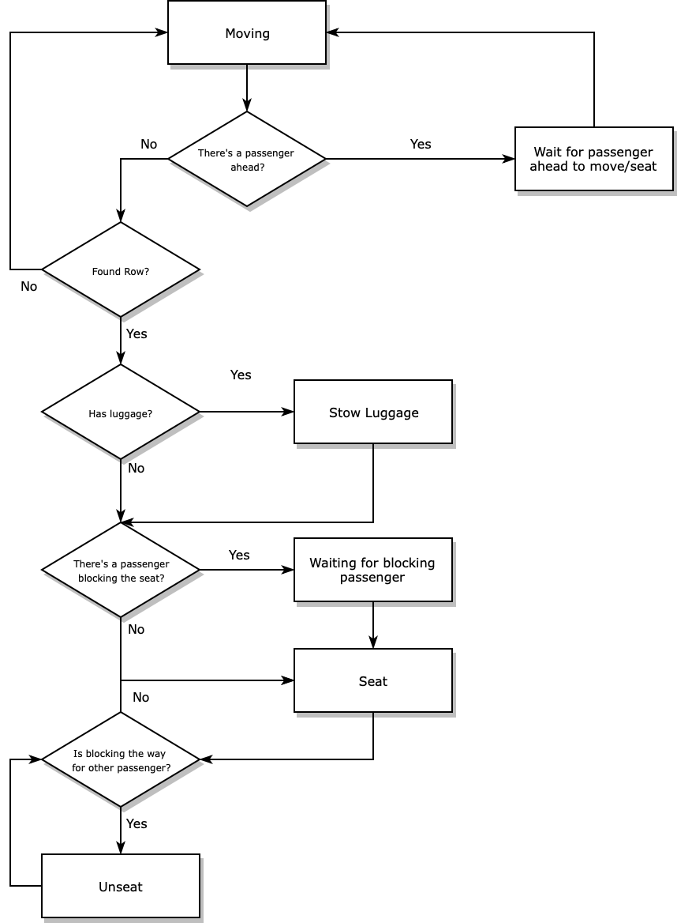
Boarding
Logic
Notes:
Let first look at the model used to portray the boarding of passengers,in order to understand better how it works. Here we assume that each passenger behaves perfectly, like a machine. This means that each one walks at the same speed (1 tick/patch), they obey the order they enter, they all take the same interval of time to stow the baggage and all start boarding the plane at the same time. A completely unrealistic scenario but easy to implement ,and simple to explain.
Then for each run each passenger follow the same logic of procedure. All passenger are ordered in a queue
Passenger checks if it is in its row
If not, checks if there is no passenger ahead blocking the ahead. If there is he waits for the passenger ahead to move, otherwise he moves a patch
If yes, in case he has luggage he will store the luggage (this can cause aisle interferences, that will be explained after)
Checks if there is a passenger blocking his way into the seat (this is a seat interference)
If yes, he waits for the other passenger to get way and then goes to his seat
if not, goes directly to his seat
When already seated the passenger might need to unseat to let other passenger go through

Slide 5
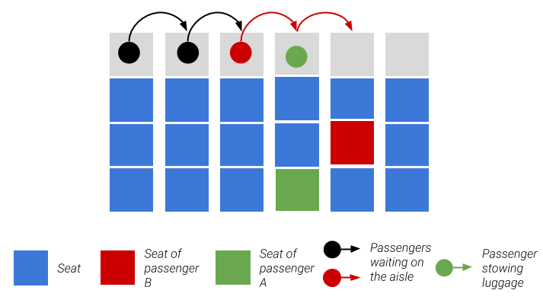
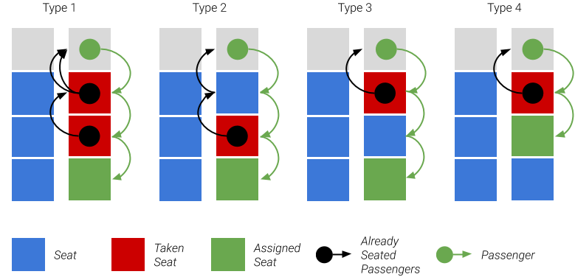
Interferences
Aisle Interference
2. Seat Interference
Notes:
There is two types interferences that may happen when boarding. This interferences are important to evaluate the quality of a boarding method, because it may cause discomfort to the passengers.
Aisle Interference.
Happens mostly when a passenger is blocking the movement in the aisle because it is stowing the luggage. (Might reference the fact that in real life scenarios the passenger blocking the aisle may let the person behind go through)
Seat interference
Happens whenever a passenger wants to go to his seat but there are already people seated in the seats next to it, forcing the people already seated to stand up and go to the aisle ( we will always assume that resolving this type of conflict the passengers already seated need to unseat and go to the aisle, there is no trickery, like stand up in his seat or something similar).
We identify 4 types of possible seat interferences (explain briefly each one)
Type 1 might be the worse because it is one that takes the most time and dissatisfies the greater number of people

Slide 6
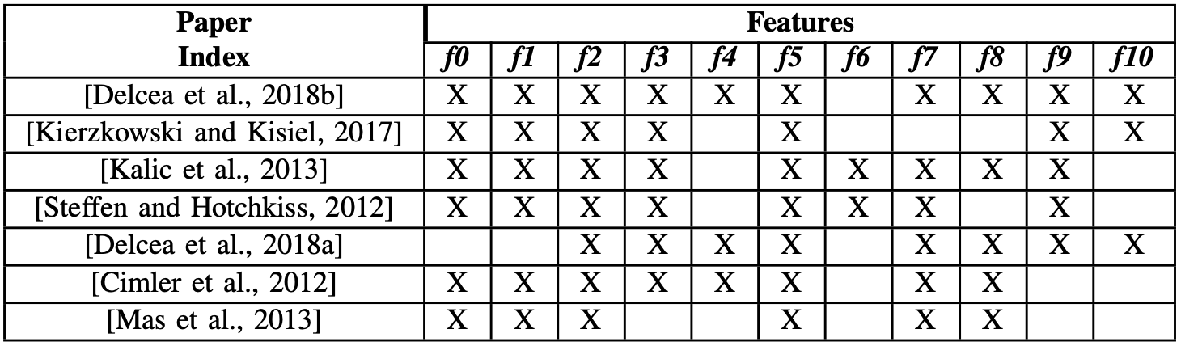
Related Work
f0. Considers aisle interferences;
f1. Considers seat interferences;
f2. Considers time for stowing luggage;
f3. Considers a variable luggage count;
f4. Analyses 4 or more boarding methods;
f5. Uses a single-aisle layout;
f6. Has a passenger satisfaction metric;
f7. Finds an average boarding time;
f8. Uses simulation instead of just observation;
f9. Finds a deviation for individual boarding;
f10. Uses human behaviour.
There’s a gap on researches considering both simulation and human behaviour
Notes:
Talk there is a lot of papers related to this problem, identifying what they consider and what not.
Although 2 of them consider both human behaviour and simulation, the first one does not go deep on how users behave when they are causing an interference such as letting other to pass among other scenarios that happen on real-life. The second also takes human behaviour into consideration but more in a perspective of how people behave while boarding on random method without seat assigned.
Identify that the human behaviour aspect we implemented is different from what was already done in terms of simulation

Slide 7
Motivation
1. Simulate airplane boarding in the most realistic way possible
2. Use of human behavioural metrics
3. Easy and cheap way to test different ways of boarding people on an aircraft
Simulation environment
No Human Behaviour
Confirm Literature conclusions
Human Behaviour
Viability of previous Conclusions in different Scenarios
Notes:
We want to confirm what was concluded from the other papers related to this topic. But also, we would like to enforce the viability of those conclusions. As such, we want to implement a simulation as close to reality as possible, by evaluating human behaviour. Simulation of these topic is the best way possible to test because it the most affordable and easiest way.
How did we do it?
We decided to divide the testing in two segments, one without the human factor (default methodology explained before) similar to all the simulation papers have done, so we could confirm the literature conclusions. And then we made tests with human behaviour to check the viability of the conclusions.

Slide 8
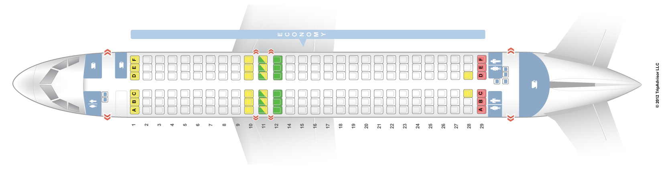
Simulation Plan
1. A320 - 30 rows, 6 seats per row, total of 180 passengers
2. 9 different boarding methods
3. Run simulations in different scenarios
4. Gather total boarding times
5. Gather total number of interferences of each type
6. Calculate passengers dissatisfaction level
7. Analyse data and conclude/confirm best method
Notes:
1 We decided to test the boarding time in a a320 airplane layout because it is the most common layout used by airline companies
2 There is more but we used the most common and recommended ones.
3 Again the scenarios with and without human factor
4-6 gather data to take

Slide 9
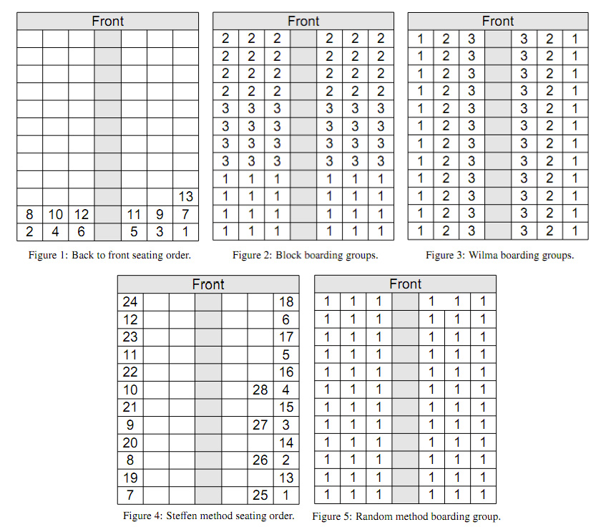
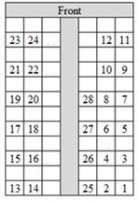
Boarding Methods
1. Random
2. Back to front /Front to Back (row and block)
3.Wilma
4. Steffen
5. Kautzka 3
Notes:
Front to back was tested to see what is the worst case scenario will be (this method counter productive of course)
Back to front and random are the most used
Steffen and Kautzka are considered the perfect methods
Wilma although not applied a lot, is simple to apply.
Kautzka is basically a fork of the steffen that separates people in groups of 2 people (we also tested with groups of 3 people)

Slide 10
NetLogo
Notes:
Speak about inputs.
Input below luggage_speed (inclusive) are related to the human behaviour.
Luggage speed only works with distributed passenger speed of. We decided using a distribution was the better approach

Slide 11
Default
Testing
Scenarios
2 Scenarios
1. No passenger have luggage
2. 50% of the passenger have luggage
BehaviourSpace - 100 runs
1 - Boarding Time
2 - Number of aisle interferences
3 - Number of seat interferences

Slide 12
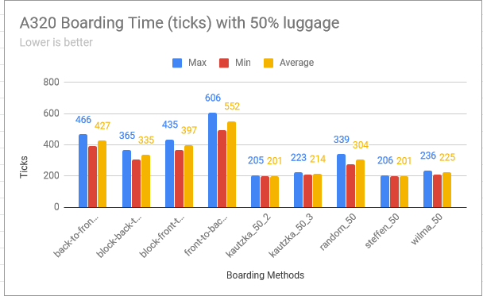
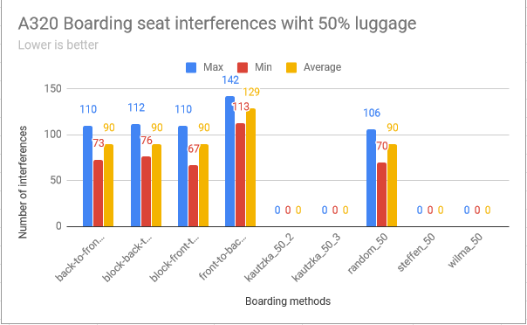
Results of default tests
Kautzka 3, Steffen and WILMA are the most performant methods in accordance with the literature studied
Notes:
This is an example of some of the charts and data gathered, there are a lot more of course. From the data obtained we could concluded that Steffen, Kautzka and Wilma are the best methods overall. Being Kautzka and Steffen the slightly better ones. This is expected since that these two methods were made to be extremely efficient. We could see that the random method still performs pretty good for what it is.
This data goes hand to hand, with the conclusions in other papers. But can these methods still stay on top when applying to a more realistic scenario?

Slide 13
Human
Behaviour
Metrics
Passenger Variety
Luggage Stowing strategy
Entrance rate strategy
Human sympathy
Notes:
When we decided to implement human behaviour, we took into consideration 4 main factors.
Each person is different, this means that not everyone walks at the same speed, some people are faster than others. We used a normal distribution of 1.3m/s with deviation of 0.25m/s
Realistic times passengers waste stowing luggage in various scenarios.
Entrance rate where people enter the plane in different rates
Human sympathy where there are situations (only 2) where a passenger may let the other one behind him pass through

Slide 14
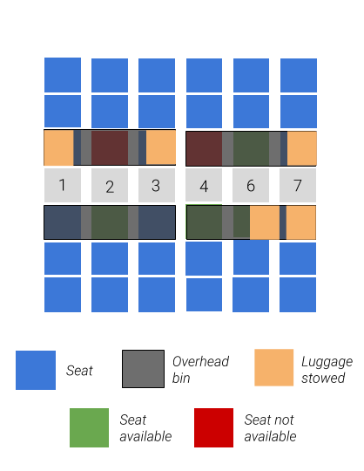
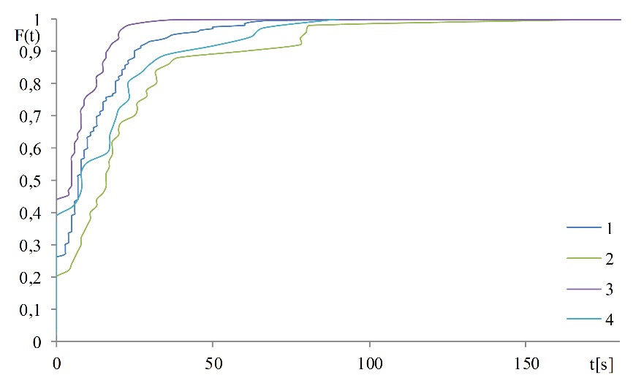
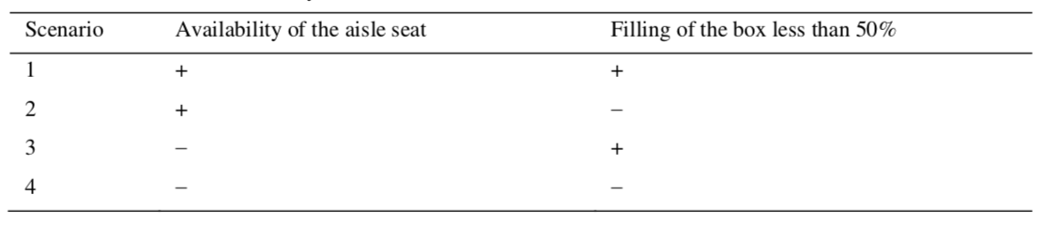
Luggage Stowing Time
Notes:
For defining the time spent stowing luggage, we used a cumulative empirical distribution obtained through a test made in real life scenario by Kierzkowski and Kisiel.
When a person try to store the luggage, he looks mostly and space directly below his low, and the rows exactly to his right and left. (So watching the right image a passenger in row 2 is going to check the availability of space in overhead bins that consume the rows 1 2 and 3. Each overhead bin, we assume that support at most 4 baggages.)
For each scenario specified, different values are used.
Explain each scenario.
Scenario 1 seen in row 6 looking up (93% to let passenger behind go through this percentage decreases for each passenger that goes through)
Scenario 2 seen in row 6 looking down (93% to let passenger behind go through this percentage decreases for each passenger that goes through)
Scenario 3 seen in row 4 (53% to let passenger behind go through this percentage decreases for each passenger that goes through)
Scenario 4 seen in row 2 (53% to let passenger behind go through this percentage decreases for each passenger that goes through)

Slide 15
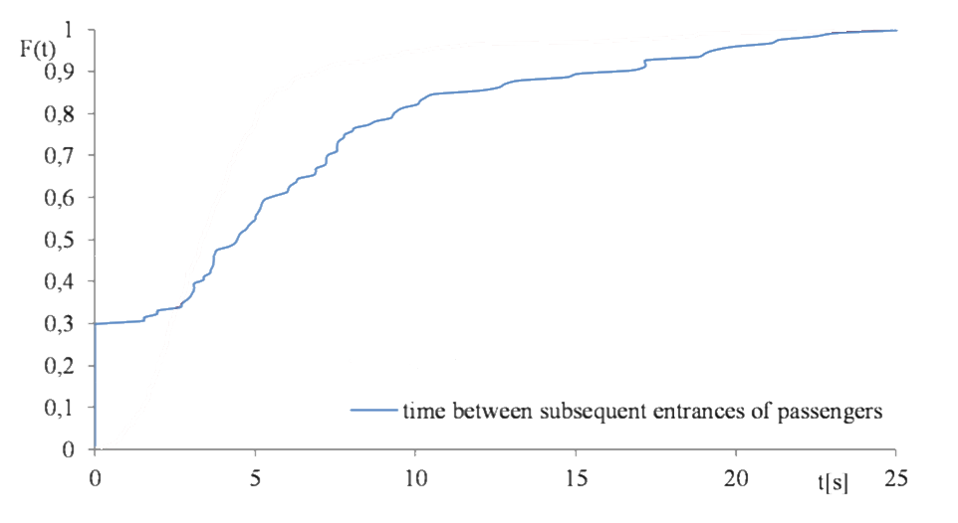
Passenger Entrance Rate
People have different needs so some of them may take some time to enter the aircraft since they have to show their boarding ticket to the crew and it may not be always on their hand ready to be shown
Notes:
Another empirical cumulative distribution. This is the rate people enter the plane this mean that when a person enters the airplane, does not mean that in the next run the following passenger is already boarding the plane. (Simulate people need to walk from the airport gate to the plane itself, of course we assume that no one surpasses anyone before entering the airplane, the ordered specified by the method is always maintained)

Slide 16
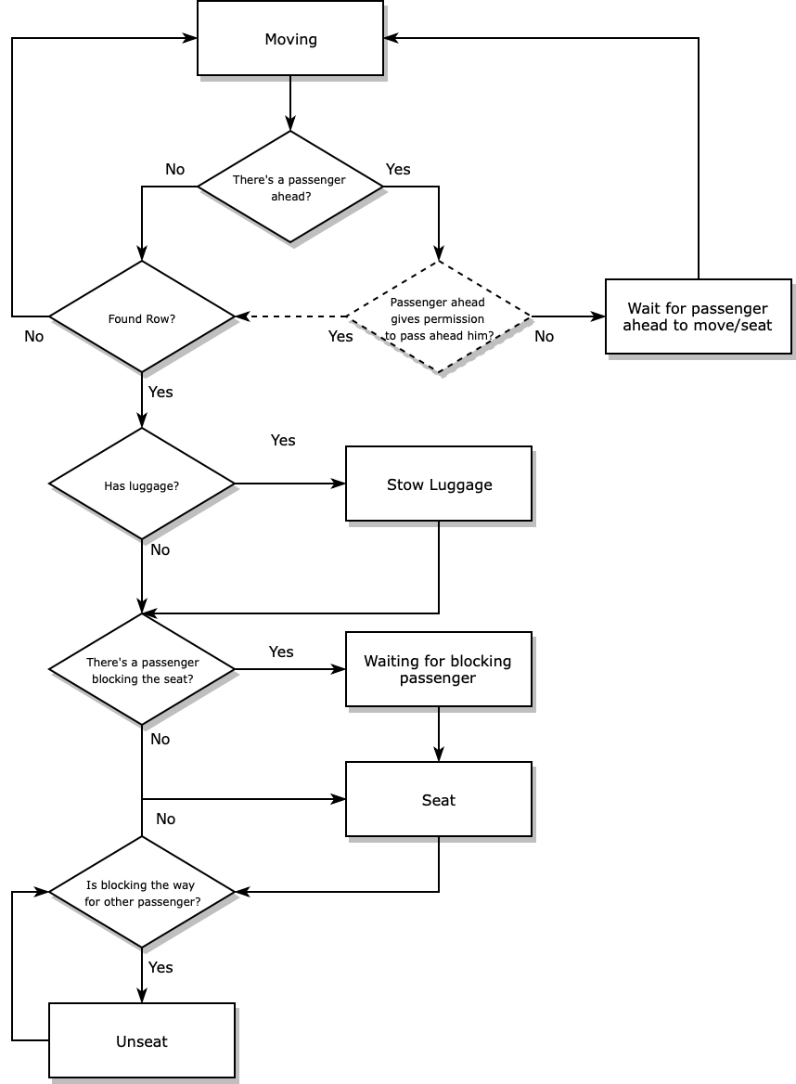
Boarding
Humanized Passengers
Notes:
The final logic of modeling the problem is practically the same as the default implementation, we just add the possibility of passenger let the other passenger go through them. There is two occurrences where this could happen.
The first one was explained before, in the stowing time strategy, there is a possibility of 93 or 53 chance (depending in what case) to let the next passenger go through while stowing luggage
The second occurence, is when a passenger that is ready to sit, checks that the passenger before him (that does not bring luggage) is going to sit in the same row as him in a position that would imply a seat interference. As such if the passenger predicts a seat interference we will let the other behind go to his seat first.

Slide 17
Human Behaviour
Testing
Scenarios
2 Scenarios
1. No passenger have luggage
2. 50% of the passenger have luggage
BehaviourSpace - 100 runs
1 - Boarding Time
2 - Number of aisle interferences
3 - Number of seat interferences
4 - Dissatisfaction of each passenger
a - Boarding time
b - Time on aisle interferences
c - Time on seat interferences
Notes:
Dissatisfaction of each passenger is calculated by dissatisfaction=0.7*tibt+0.2*iai+0.1*isi where:
tibt - total boarding time of a passenger
iai - total time wasted by a passenger in seat interferences
isi - total time wasted by a passenger in aisle interferences

Slide 18
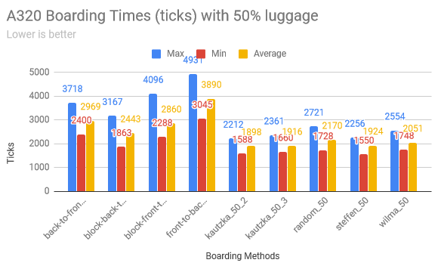
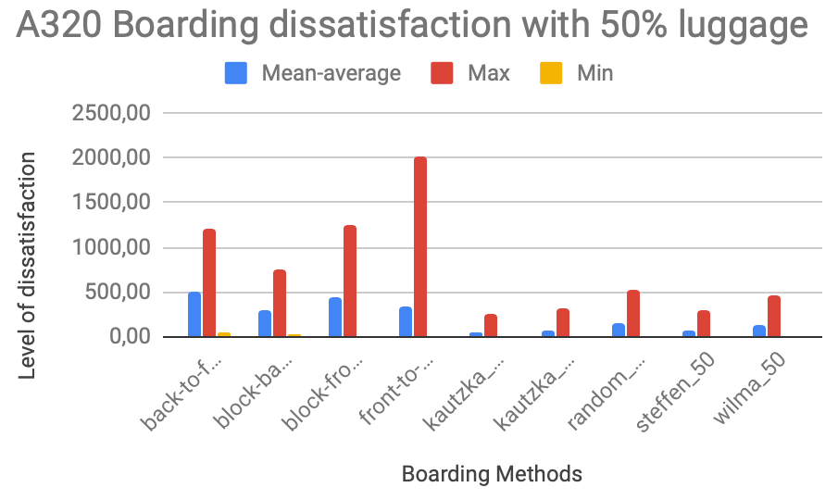
Results of Boarding passenger with Human Behaviour
1. Best methods remain the same
2. WILMA takes a little more time
3. Methods which take less time are also the ones with better satisfaction
Notes:
Still here we can check some of the data gathered in these tests (of course there is alot more). Overall we can check that story repeats itself, Steffen and Kautzka are the better ones (WILMA is not as close as before in terms of boarding time, but still prefers performs admirably).
Brief talk about the dissatisfactions levels being way lower in the best methods than the others.

Slide 19
Conclusion
Theory
Kautzka and Steffen are the best methods
Reality
These methods don’t work!
Wilma then?
Maybe the best method is not using any method at all
Notes:
Looking only at the results we could say that Steffen or Kautzka should be implemented. But we advise against it. Why?
Its simple, Steffen/Kautzka are perfect methods they follow a specific order of entrance, this means that for steffen you need to organize up to 180 persons in a specific order (90 groups or 60 of 2 and 3 people respectively for Kauztka), this level of organization is basically impossible to achieve, it might take more time preparing for entering the plane that boarding it :)
So, one could say that Wilma is the better option. Well kinda, Wilma performs quite well (not as good as the perfect ones, but still close enough) and easier to implement, organize people in group of window, middle and aisle. But there is caviat, Wilma does not take into consideration grouping, this means that people that come together will not enter the plane together, this can be a hassle for a lot of people, especially for parents who bring their children with them. So, Random might the best , it performs quite well overrall (it competes well with Wilma), difficulty of implementing it is 0 and if people want to go together they can.
A lot of work, just to find out the best method might not using any method at all

Slide 20
Future work
Good results but...
1.
Model the time needed to solve seat interferences
2.
Deep understanding on what people really care about:
a. Boarding in less time
b. Not so many interferences
c. ...
Notes:
Despite all the conclusions we gathered, we may not be completely correct. There is always room for improving our simulations to gather even more viable data, for example, we did not apply any kind of distribution for the time solving a seat interferences. Each type of interference as a fixed time.
Our formula of dissatisfaction, may not be the best. Try to understand what people care more about, total boarding time, aisle interferecnes,seat interferences or/and other.

Slide 21
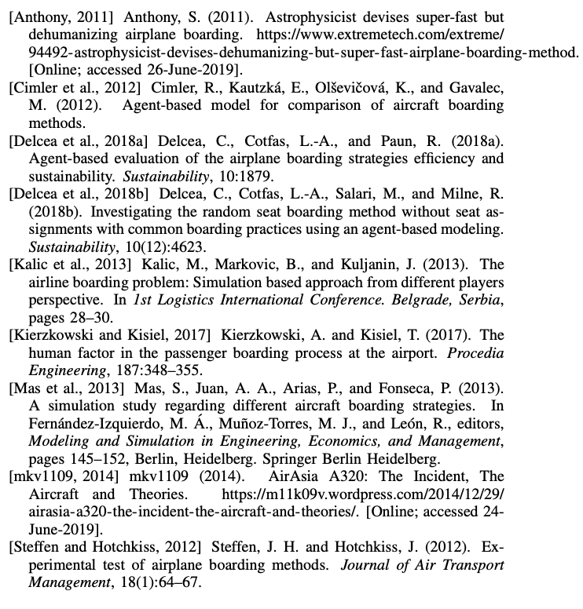
References

Slide 22
Thank you! Questions?

